Slide 1
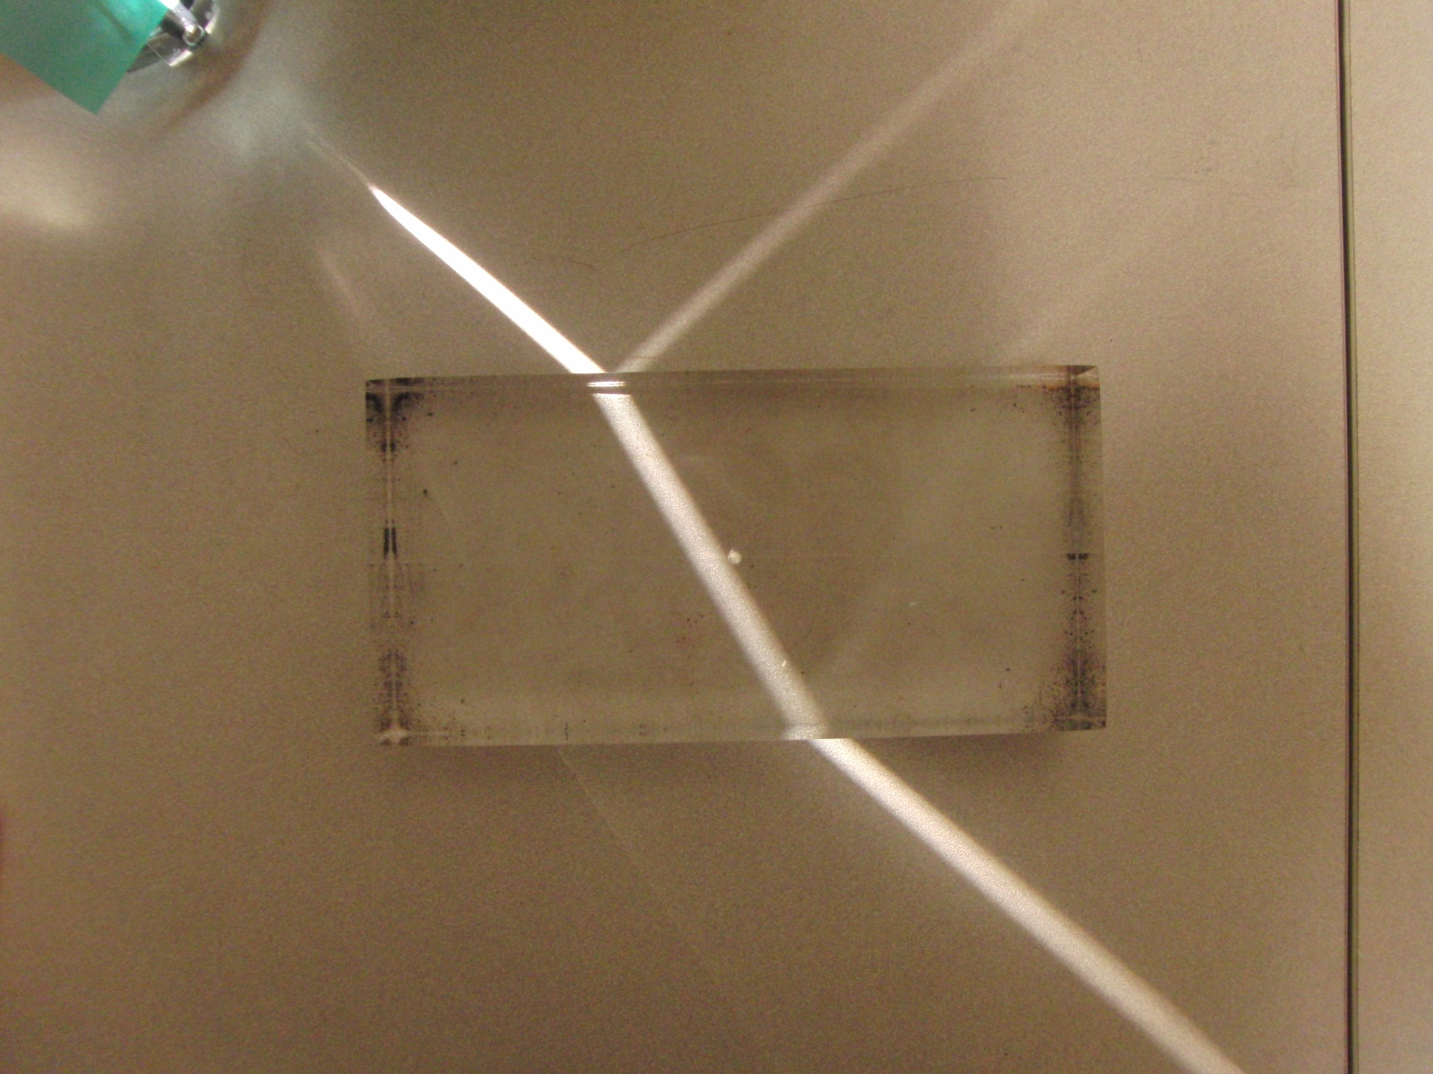

Slide 2
Question 223.14.1
To the left is a photo of several light beams. Is the light traveling
from the right to the left
From the left to the right
Can’t tell

Slide 3
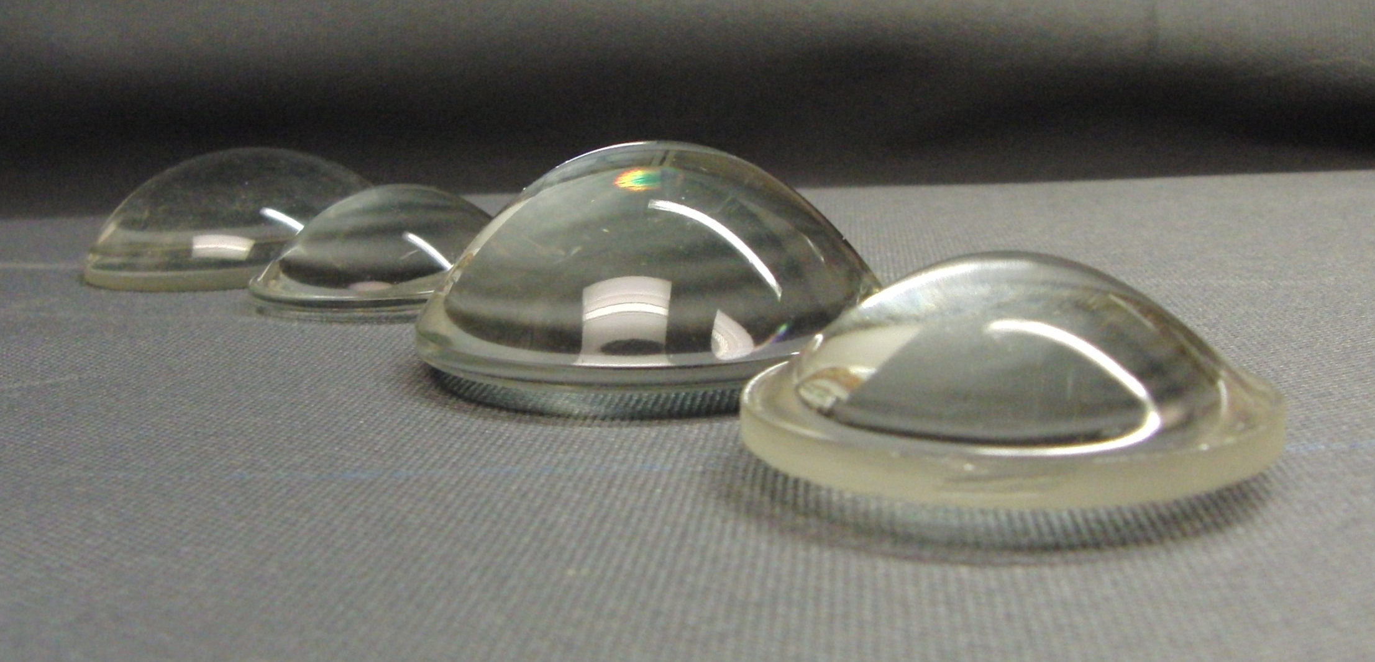

Slide 4
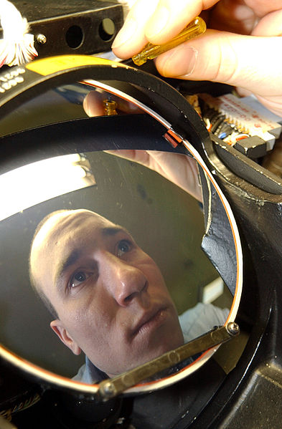

Slide 5
Question 223.14.1.5
We have found that when a wave enters a material, its speed may change. But we remember from wave theory v=λf But it is time to review: does λ change, or does f change? Wavelength
Frequency
Both
Can’t tell

Slide 6
Question 233.14.2
Suppose we have a material with an index of refraction of 2. What is the speed of the light in this material?
c/2
c/4
2c
4c
Can’t tell

Slide 7
Question 223.14.3
Light passes from a material with index of refraction 1.3 into one with index of refraction 1.2. Compared to the incident ray, the refracted ray
bends toward the normal
is undeflected
bends away from the normal

Slide 8
Question 223.14.4
If beam 1 is an incident beam, which of the other four beams lines are reflected beams and which are refracted beams?
Only beam 2 is reflected.
Only beam 4 is reflected.
Beams 2 and 4 are reflected.
Beams 2, 3, and 4 are reflected.
All five of the other lines are reflected.
1
2
5
3
4
6

Slide 9
Incident Ray
Reflected Ray
θ₁
θ₃
Air
Fast
n₁ (Small)
Glass
Slow
n₂ (Large)
θ₂
Transmitted Ray

Slide 11
Incoming Plane Wave
Scatterers
Spherical scattered wave forming

Slide 16
Reflected Plane Waves

Slide 19
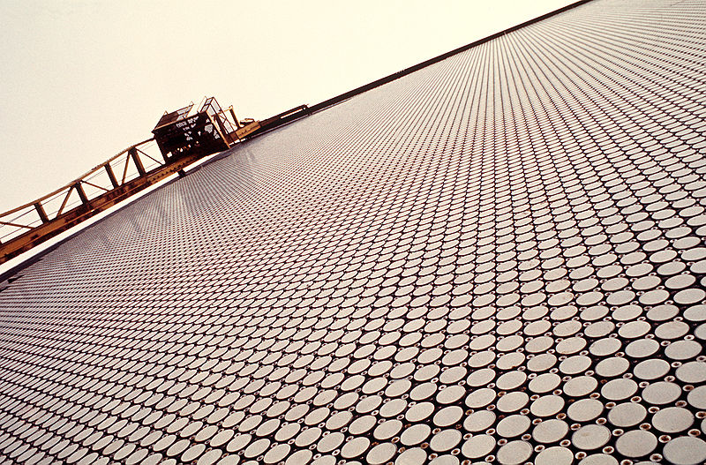
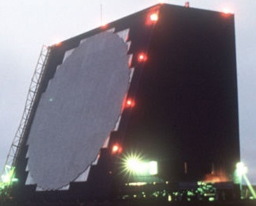
Cobra Dane Radar

Slide 20
Steered Radar Beam
RF Emitters with phase delays

Slide 22
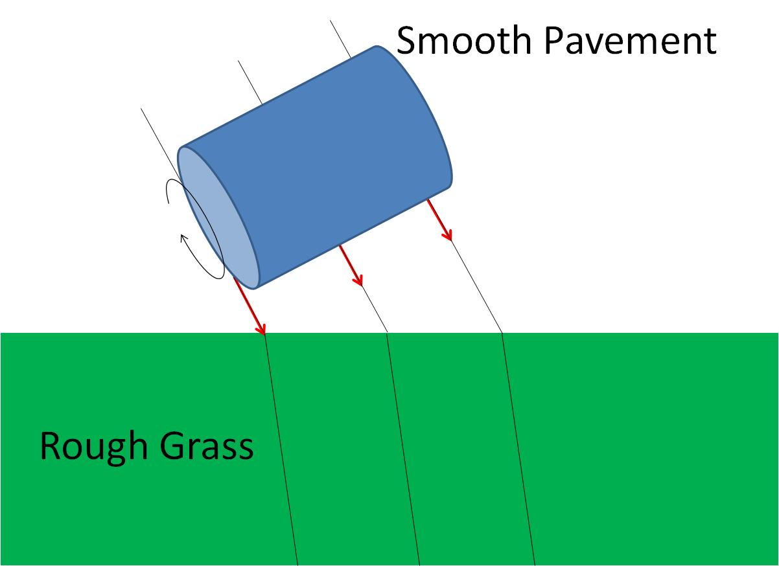
Smooth Pavement
Rough Grass

Slide 23
Smooth Pavement
Rough Grass

Slide 24
Smooth Pavement
Rough Grass

Slide 25
θ_{i}
θ_{t}

Slide 26
θ
φ

Slide 27
Question 233.14.5.5
Some text books use the word “medium” to refer to glass or some transparent material. Is glass the wave medium for light?
Yes of course
No
Can’t tell

Slide 28
Question 223.14.5
As light from the Sun enters the atmosphere, it refracts due to the small difference between the speeds of light in air and in vacuum. The optical length of the day is defined as the time interval between the instant when the top of the Sun is just visibly observed above the horizon to the instant at which the top of the Sun just disappears below the horizon. The geometric length of the day is defined as the time interval between the instant when a geometric straight line drawn from the observer to the top of the Sun just clears the horizon to the instant at which this line just dips below the horizon. Which is longer?
the optical length of a day
the geometric length of a day

Slide 29
Question 223.14.5.5
The index of refraction of the Lucite block is 1.4. The angle θ_{i} = 20°. What is θ_{t}?
14. 14 °
0. 247 °
0.499 °
28. 61 °
θ_{i}
θ_{t}

Slide 30
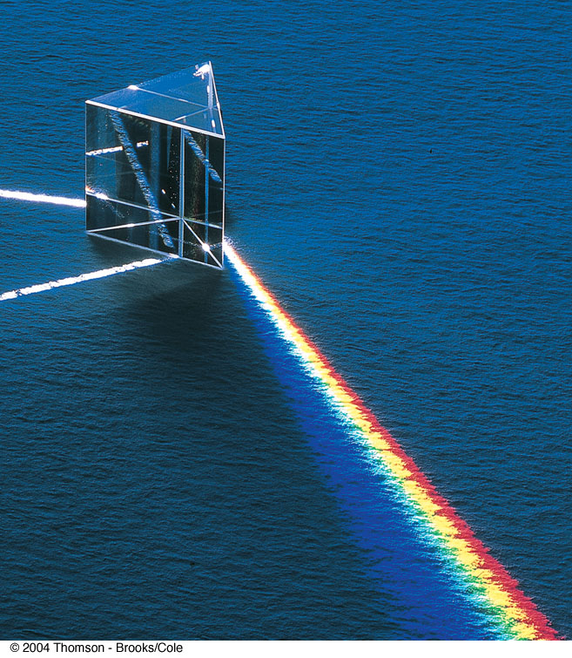
Question 223.14.6
In the picture to the right, there is a input white light ray, and a dispersed set of rays. There is another white ray. Why might that be?
It took two rays of white light to make the rainbow bright enough.
It is an optical illusion, it is not really there
It is due to internal reflection
It is the refracted ray leaving the prism.

Slide 31
Transmitted Ray
θ₂
Air
Fast
n₂ (Small)
Glass
Slow
n₁ (Large)
θ₁
θ₃
Incident Ray
Reflected Ray

Slide 32
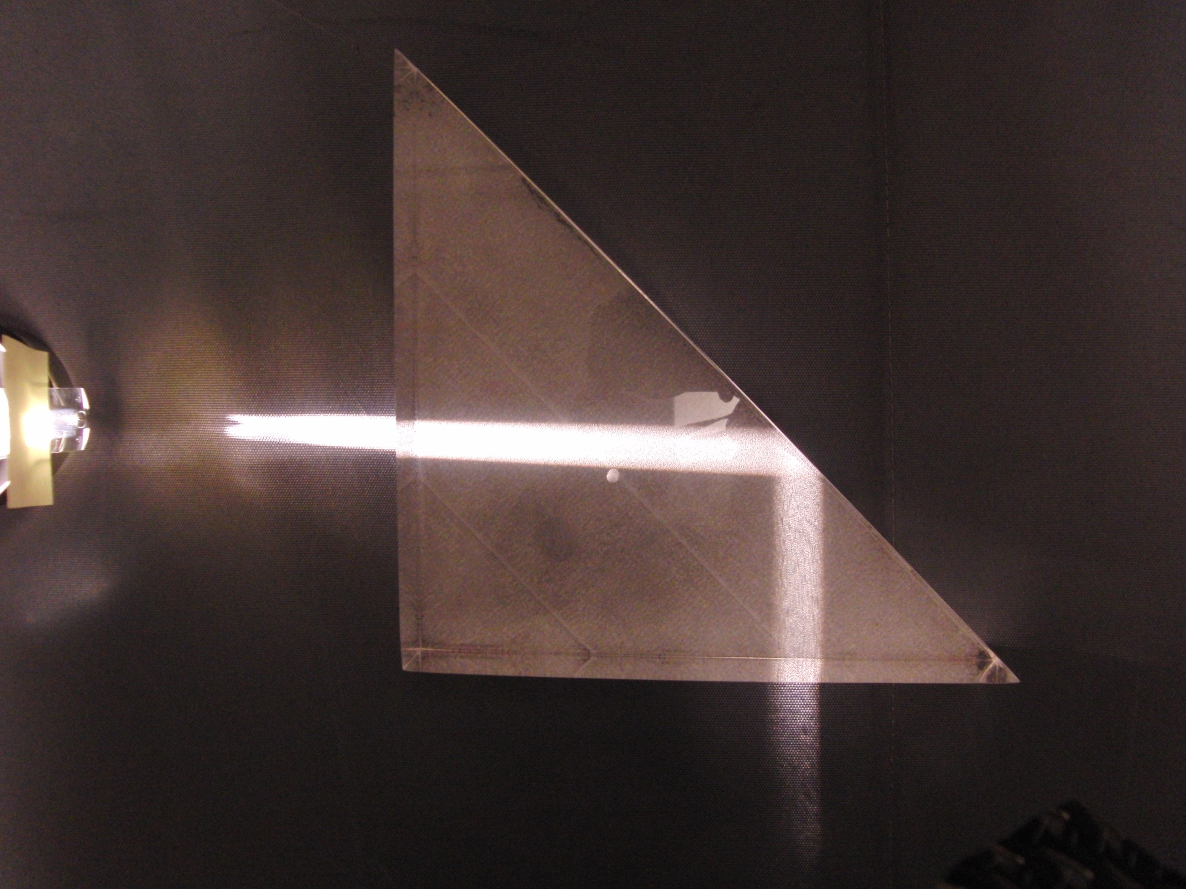

Slide 33
Fast
n₂ (Small)
Slow
n₁ (Large)
θ_{c}
Source

Slide 34
θ_{t}
θ_{c}
θ_{i}

Slide 35
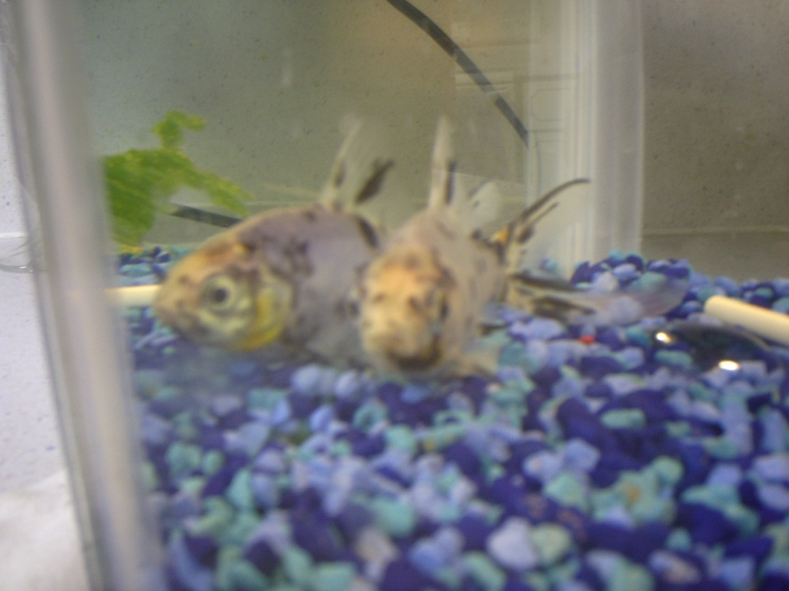

Slide 36
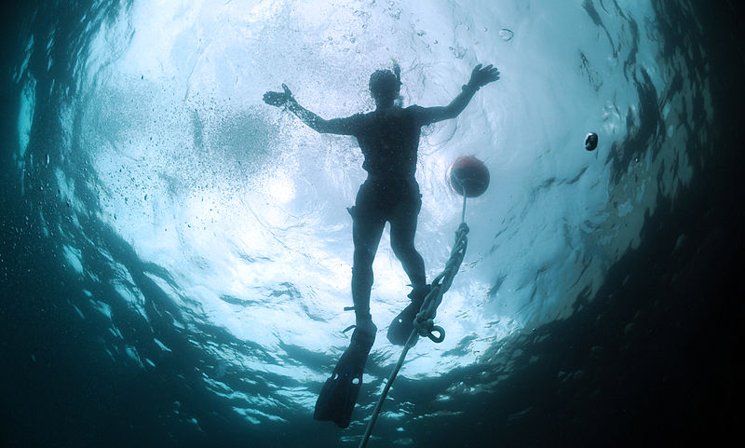
Image courtesy US Navy: http://commons.wikimedia.org/wiki/File:US_Navy_120208-N-TS452-068_Mass_Communication_Specialist_1st_Class_Jayme_Pastoric_trains_Mass_Communication_Specialist_3rd_Class_Scott_Raegan,_a_ne.jpg

Slide 37
Question 223.14.7
You are on a boat, and you are watching a night diving expedition. The divers carry powerful flashlights. To you, the flashlights seem to be a dispersed set of small lights. Why?
The light must come from many flashlights to seem to come from more than one spot
The light is sometimes reflected due to total internal reflection and sometimes not because of the surface waves
The light is blocked by fish and other sea life
Can’t even guess

Slide 38
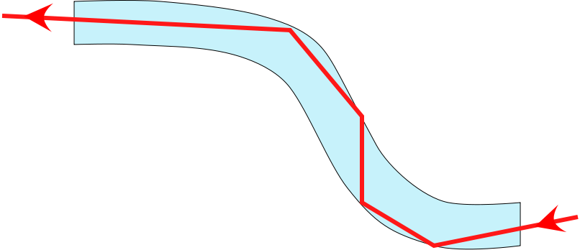
Fiber Optics

Slide 39
Fiber Optics

Slide 40
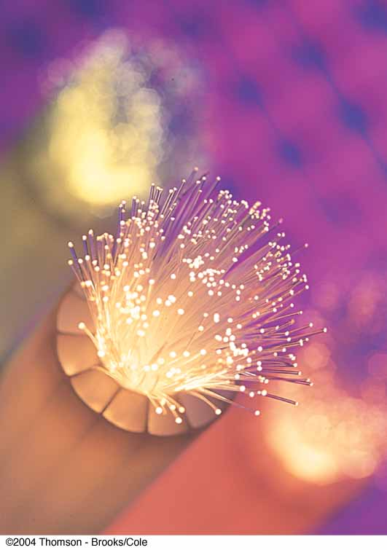
Fiber Optics, cont.
A flexible light pipe is called an optical fiber
A bundle of parallel fibers (shown) can be used to construct an optical transmission line

Slide 41
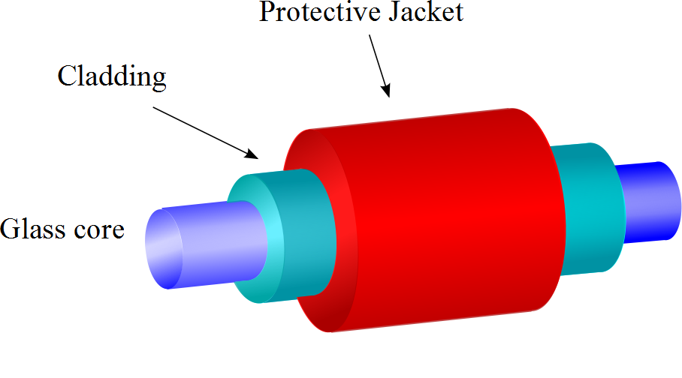
Construction of an Optical Fiber
The transparent core is surrounded by cladding
The cladding has a lower n than the core
This allows the light in the core to experience total internal reflection
The combination is surrounded by the jacket

Slide 42
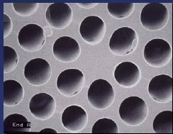
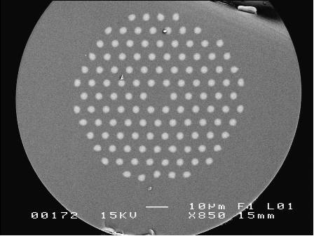
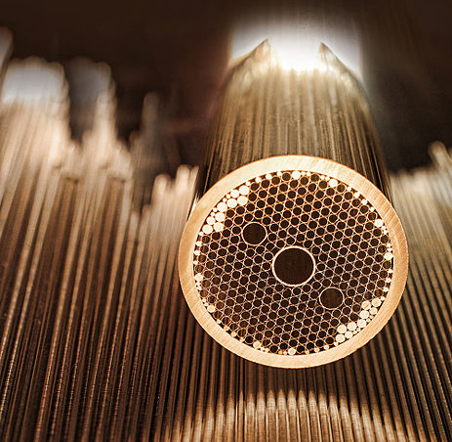
Modern Hollow-Core Fibers
Figure 2. Solid photonic bandgap fibre with isolated high-index cladding rods and a low-index core..
Solid photonic bandgap fibre with isolated high-index cladding rods and a low-index core. (J. C. Knight, "Origins and limitations of photonic bandgap guidance in optical fibres", photon06.org/Microstructured%20photonic%20materials%20Wed%20%2010.15.doc)
Hollow-Core Fiber (Courtesy Defense Advanced Research Projects Agency (DARPA), image in the public domain)

Slide 43
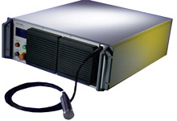
Example: Fiber Lasers
IPT Photonics YLR- LP Series: 10 to 500W Single Mode Linearly Polarized Ytterbium Fiber Lasers
Main Features:
1060 to 1070nm Wavelength Range
Extinction Ratio &gt;20dB
TEMoo (M2&lt;1.1)
Air or Water Cooled Versions
100,000 hours Est. Pump Diode Lifetime
Maintenance Free Operation
Single Mode Fiber Delivery
Applications:
Materials Processing
SHG
Medical
Scientific

Slide 44
Question 223.14.8
You are fishing and wish to catch a big one. You want to sneak up on the fish. Can the fish see the shore line?
It depends on where the fish is relative to you and the angle you subtend from the horizontal
No, fish cannot see out of the water due to total internal reflection
Fish can see the shore line, but it can see things overhead better.
It depends on what color you are wearing. The water causes dispersion

Slide 45
Lens
Image
Light Source

Slide 46
Fish out of water
Rays from fish head
Eyes
d
Rays from fish tail

Slide 47
Fish out of water
Rays from fish
Eyes
d
Rays from fish
Fish in water
Image of Fish
Rays appear to come from here
d’

Slide 48
s
s’
Rays from fish
Fish in water
ℓ
Image of Fish
θ₂
θ₁
ℓ
θ₁
θ₂
Rays appear to come from here
n₁ (Large)
n₂ (Small)

Slide 49
Object
[Figure]
Convergence Point

Slide 50
A
θ_{i}
θ_{t}
η
S
d
P
α
β
γ
V
C
R
s_{o}
s_{i}

Slide 51
Question 223.14.9
You are building a complex optical device on an optical bench. You are out of mirrors. Can you use a prism instead?
Yes
No
Maybe

Slide 54
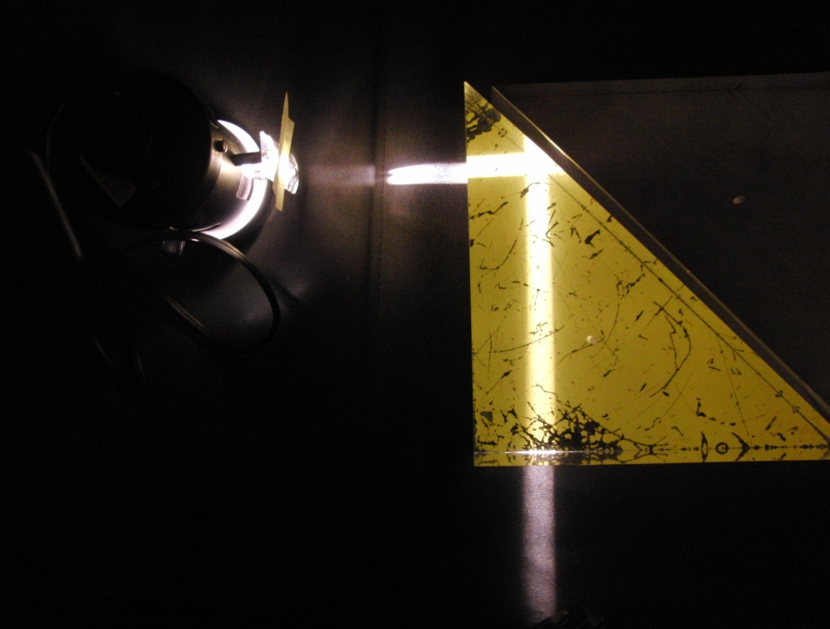
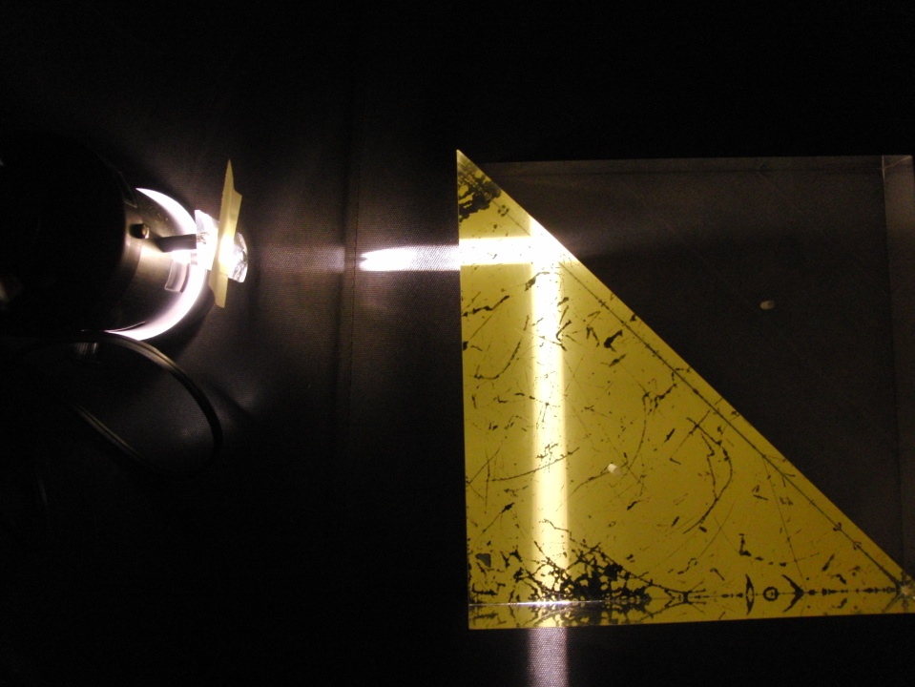
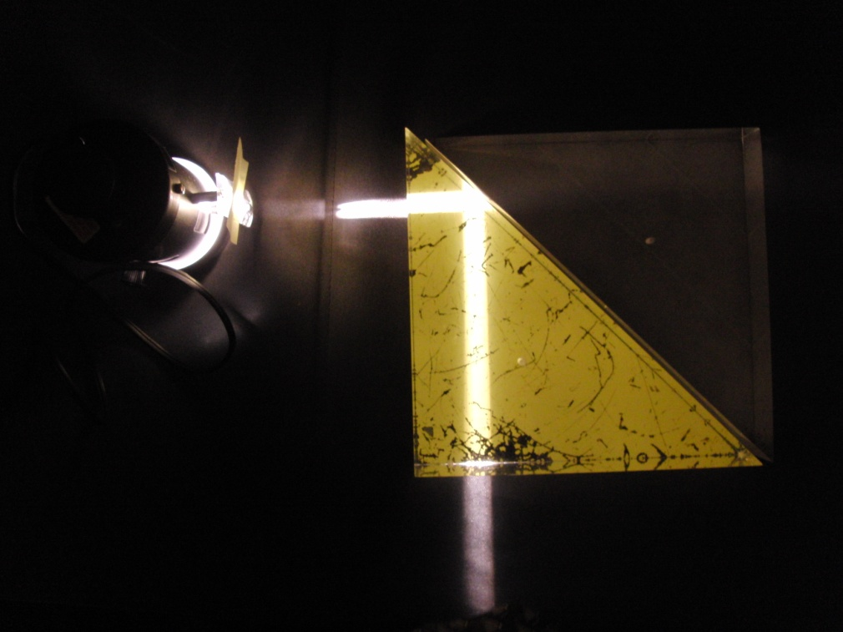
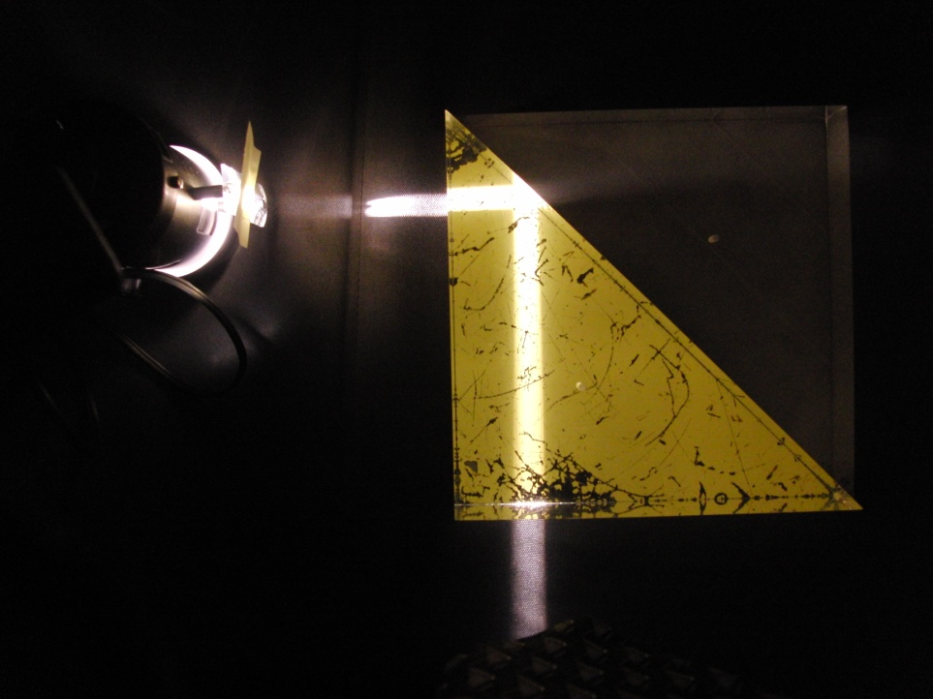
(a)
(b)
(c)
(d)

Slide 55
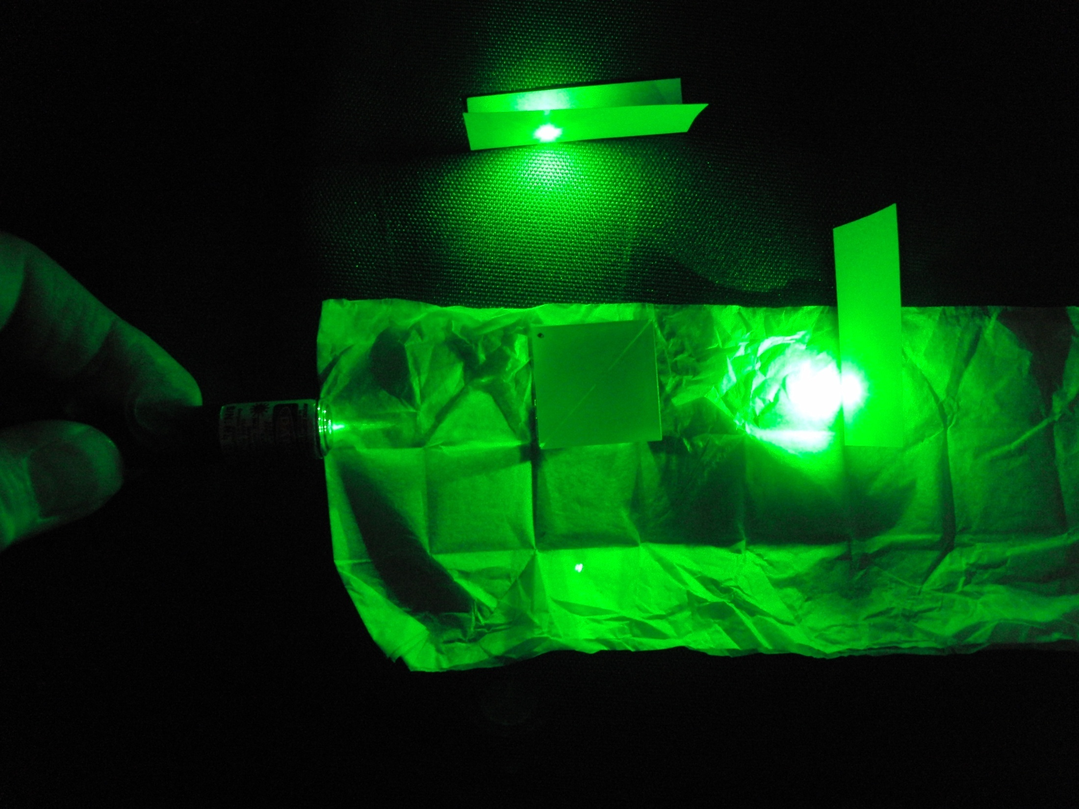
Internally Reflected Beam
Beam Splitter
Laser Pointer
Frustrated Total Internal Reflection Beam

Slide 56
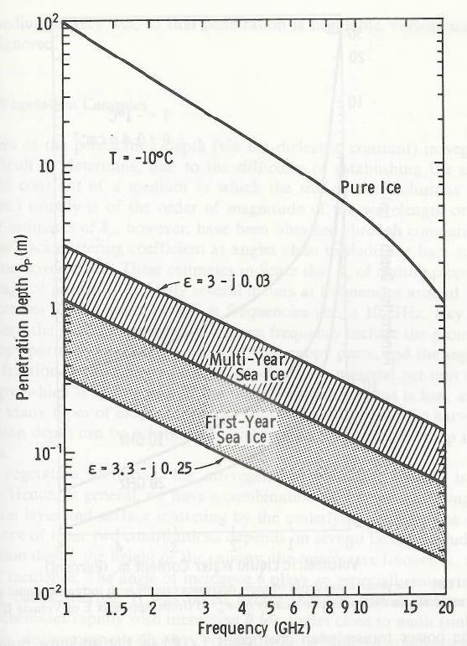
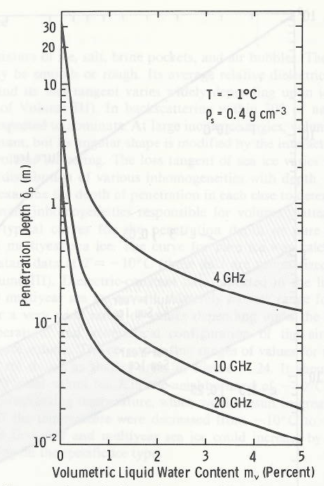
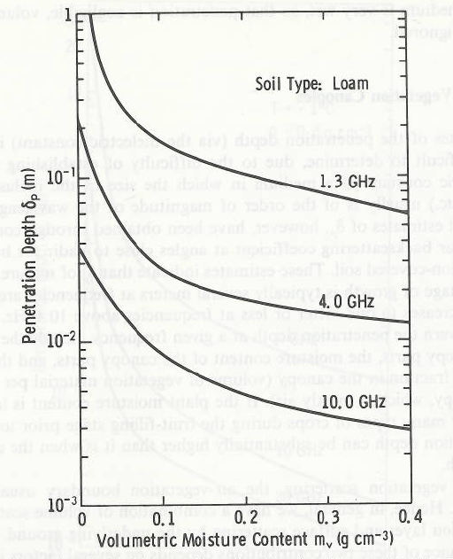

Slide 57
Question 14.10
In the graph to the right, the peaks tell us …
a) Which frequencies are in a musical note
b) Which frequencies will cause standing waves
Which frequencies sound good
Which frequencies are in tune.
Input Impedance
Frequency (Hz)

